Slide 1
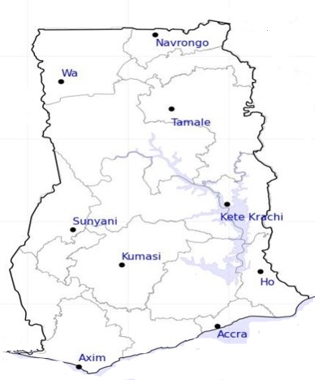
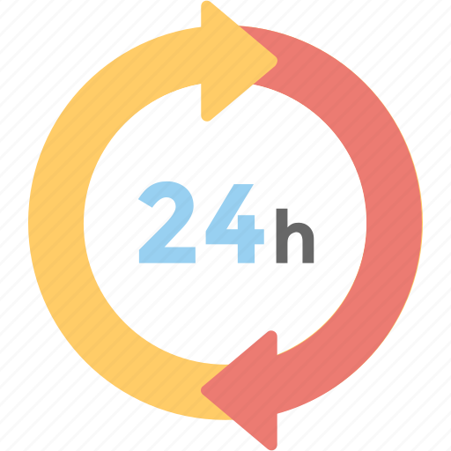



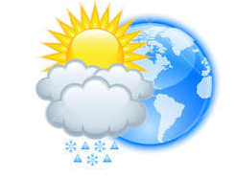






WEATHER FORECAST
24-HOUR FORECAST
18-11-2022 @ 1200 UTC
Rain
Wind
Dust
.
Forecast Summary (KUMASI)
 | DAY | NIGHT
Temperature | 31 | 24
Rain | No | No
Probability | - | -
Rel. Humidity | 68 % | 85 %
Winds from | S | S
Wind Speed | 2 ms⁻¹ | 2 ms⁻¹
Wind Gust | - | -
Low risk
Be aware
Be Prepared
Take Action
AXIM
Light rains at day
LORD BRIGHT BOATENG
SUNSET: 05:45 PM SUNRISE: 5:54 AM
POWERED BY:

